Slide 1


Welcome
To
MS Power Point

Slide 2


Introduction
MS Office is an Application software developed by Microsoft corporation USA . Microsoft was founded by Bill Gates and Paul Allen on 1975,
Microsoft Corporation, leading developer of personal-computer software systems and applications.
MS Office is mainly used for office work such as
Documentation
Worksheet
Presentation

Slide 3
Introduction
Microsoft Office is designed specifically ft for business use. It is a proprietary product of Microsoft Corporation and was first released in 1990.
MS Office has been a dominant model in delivering modern office-related document-handling software environments.
Microsoft Office is available in 35 different languages and is supported by Windows, Mac and most Linux variants.

Slide 4

MS Power Point
Microsoft PowerPoint is a powerful presentation software developed by Microsoft. It is a standard component of the company's Microsoft Office suite software, and is bundled together with Word, Excel and other Office productivity tools.
The program uses slides to convey information rich in multimedia and is used to create complex business presentations, simple educational outlines and much more.

Slide 5
How to Open MS Power Point
Start → All Programs → MS Office → MS Power Point.
Start → Run→ Type ( Powerpnt )→ Enter
Double Click on MS PowerPoint Icon on desktop
Note: .ppt for Old version and .pptx new version is the file extension, when we save the along with file name automatically gets file extension

Slide 6
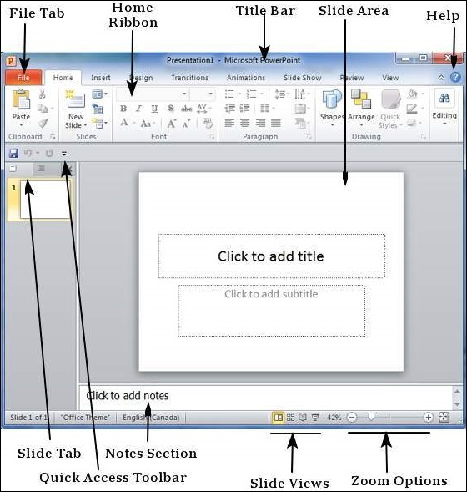
Window Screen

Slide 7
Parts of Window Screen
Title Bar : Top most bar represent as title bar it display title of the power point presentation
Quick Access Toolbar (QAT)
Is a customizable toolbar placed by default above the Ribbon. Here, you can add icons for your often used commands. The QAT can also be placed below the Ribbon.
3) Ribbon
The Ribbon has tabs which in turn contain groups of buttons for various options. Some groups also contain galleries (for example galleries for Themes and Theme Colors).
4) Slides Pane
Located on the left side of the interface, the Slides pane shows thumbnails of all the slides in the open presentation.
Note: If the Slides pane is not visible, click the Normal button in the View tab of the Ribbon.

Slide 8
5) Slide Area: Displays the active slide.
6)Task Pane
The Task Pane contains more options and appears when you choose an option in one of the Ribbon tabs. For example if you click the Format Background button within the Design tab of the Ribbon, the Format Background task pane opens
7)Status Bar
A horizontal strip that provides information about the opened presentation like slide number, applied Theme, etc. It also includes the view and zoom options.
8) Notes Pane
Right below the active slide, this is where the speaker notes are written for the current slide. Note that none of this content is visible on the actual slide while presenting, although it is visible in both Notes Page view and Presenter view.

Slide 9
9)View Buttons
Essentially there are three view buttons on the Status Bar displayed towards the left of the zoom-in and zoom-out options:
a)Normal
If you are in some other view such as Slide Sorter view, click the Normal button on the Status Bar to switch to Normal view.
b) Slide Sorter
Click this button to switch from any other view to Slide Sorter view. The Slide Sorter view displays zoom-able thumbnails of every slide in the open presentation.
c)Reading View
Click this button to switch from any other view to Reading view.
d)Slide Show
Show the presentation as a full-screen slide show from the currently selected slide. Shift-clicking brings up the Set Up Show dialog box. F5 is short cut key for slide show

Slide 10
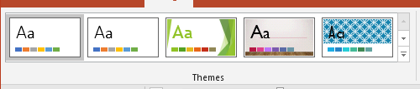
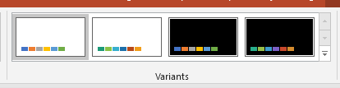
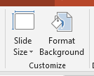

Design Tab
This allows you to change basic page elements including silde sizes, orientation, and slide numbering.
Themes - gallery Colors - Drop-Down. Fonts - Drop-Down. Effects - Drop-Down.

Slide 11
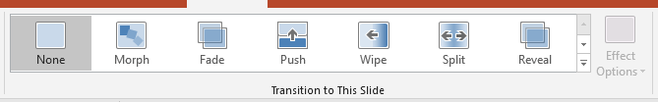
Transition
Transition are the Animation effect between two slide by giving this effect your presentation will be more attractive.

Slide 12
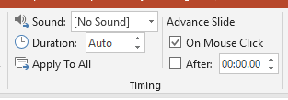
Transition
Sound - (Transition Sound in 2007) Duration - You can give time duration for sound effect Apply to All - Set the transition between all the slides in the presentation to be the same as this slide. On Mouse Click - Lets you wait until there is a mouse click before moving on to the next slide. After - (Automatically After in 2007). Lets you move to the next slide after a specific number of seconds.

Slide 13

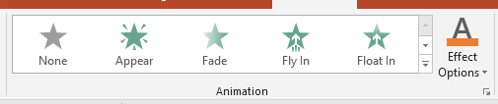
Animation Tab
You can animate the text, pictures, shapes, tables, SmartArt graphics, and other objects in your PowerPoint presentation. Effects can make an object appear, disappear, or move. They can change an object's size or color.
Preview - Preview the slide animations for the active slide.

Slide 14
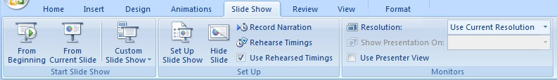
Slide Show Tab
These buttons allow you to choose how the slide show runs:
From Beginning: the slide show begins on slide 1.
From Current Slide: the normal setting: the slide show begins from the slide you are currently looking at.
Custom Slide Show: this allows you to choose which slides will be shown and which ones will not. This is in case you give a slide show, but you don't need all the slides.

